Slide 1
Some card playing techniques
The finesse. This is one of the first playing manoeuvres that starters learn. In general a finesse is a 50% chance, but the odds can be improved by a studying certain card combinations. Good players seek to avoid finesses whenever possible if there is an alternative line of play. However, nearly all hands require a finesse, so the technique is important.
♠ A 7 5 3
♥ A Q
♦ Q J 10 4 3
♣ A 10
♠ KQ 972
♥ 85
♦ A
♣ KJ1764

Slide 2
Finessing: the odds are 50%
Finessing twice in the same combination raises the odds of 1 finesse working to around 75%
Simple Finesses
AQ67 A65 KJ 63 Q96 K53
984 QJ9 A52 A73 642
Finesse the K the K the Q the K the A
Double finesses
AQ10 K10 75 KJ64
642 A8 5 1094
Finesse KJ the QJ the AQ
Card to be led in RED and underlined
If the honour card is not played by defender play card in BLUE to finesse

Slide 3
Some extra advice: 3 different examples to make more tricks
Dummy 1 2 3
J J A 4 4 K
3 6
5
2
Declarer
A A 7
K K 3
8 8
3 2
2
To make 4 tricks for 3 tricks for 4 tricks
Lead towards J Lead towards J lead 3 and
Playing for a 3-3 split duck
is a poorer option
In the absence of other information
Holding 9 cards between declarer and dummy
Finesse for the K but not the Q
Holding 10 cards, finesse for the K but not the Q
Holding 11 cards play for the K to drop

Slide 4
Some finesses, especially in the trump suit
Dummy 1 2
Q Q
9 8
7 6 2 3
Declarer
A K
6 9
5 5
3 2
1. Lead first the A then lead towards the Q, as best chance to avoid 2 losers
2. The best chance to avoid 2 losers is to lead towards the Q first. If the A does not appear, then lead towards the K and duck. You are missing A J 10 in the suit, so playing for the ace to be doubleton

Slide 5
In the absence of other information
Holding 8 cards between declarer and dummy
Finesse for the Q or K
Holding 9 cards between declarer and dummy
Finesse for the K but not the Q
Holding 10 cards, finesse for the K but not the Q
Holding 11 cards play for the K to drop

Slide 6
Some techniques for more experienced players
These include:
The ruffing finesse,
Throw ins and end plays
Loser on loser plays
Squeeze plays
Often a combination of more than one of these techniques.
Some are for very advanced players only.

Slide 7
The Ruffing finesse
The ruffing finesse is a good technique, when you have side suit with the Ace singleton already been played, and you have opposite the now void, an honour sequence. It establishes cards for discards rather than ruffing the suit out
♠ A 7 5 3
♥ A Q
♦ QJ10 9 8
♣ A 10
♠ K Q 9 87
♥ 52
♦ A
♣ K 8632
Dummy
Contract is 6♠ , and the lead is a small ♦
This contract appears safe if the ♥finesse works, but you can lose a trick in ♣ as well as a♥ if the ♥finesse fails. Win the ♦A, draw trumps, end in hand, and play ♦Q. If the ♦K comes up ruff it, otherwise discard a ♥from dummy. Now you have 3 winning ♦ to dump ♣s , and you can ruff out the suit . Taking the 2 finesses can be avoided if trumps break 3-1, and ♣ break 4-1

Slide 8
Avoiding a finesse
Whenever possible delay taking a finesse until later in the play of the hand. You may be able to set up a side suit to discard the losers
You may be able to force a defender to win in a side suit, or have to lead away from honour card, so avoiding a losing finesse
These are often called end plays

Slide 9
Establishing a long suit for discards
♠ K53
♥ K6
♦ 7 4 2
♣ A 10 6 53
The contract is 4♠. However you get a lead of the ♥Q so two immediate♥ losers and you may lose 2 tricks in ♦. After winning the return J♥, a trump is led. So draw 2 rounds of trumps with AQ. Then lead ♣ K and ♣ 7 to dummy’s A. Play a third ♣ and ruff with 10. If ♣ divide 3-3 then draw the last trump and discard 3 and 9 of ♦ on the winning ♣ . Then take the ♦ finesse, making 10 or 11 tricks
Dummy
♠ A Q J 104
♥ 10 8
♦ A Q 9 3
♣ K 7
Declarer

Slide 10
Long suit winners
You are in 3NT as South and West leads ♠A, and switches to a♣. Lucky a small ♠ was not led because that would doom the contract. Win in hand with the ♣Q and now you need ♦winners without letting East gain the lead to lead. West led from a 6 card suit headed by AKJ. Cashing the K does not help because W has no entry to the winners
So lead ♦6 and finesse with the ♦Q. Great news it holds. Cash ♣K and return to hand with ♥K. Now lead ♦4 and the ♦K comes up from West. If you win this trick the contract is down so let West win the trick.. The contract is now safe because you have 3 more winners in ♦, together with 2 in♥ and 3 ♣.
♠ 87
♥ ΑJ53
♦ AQ1087
♣ K 8
Dummy
♠ Q10 6
♥ K 6 2
♦ 6 4 2
♣ A Q 9 3

Slide 11
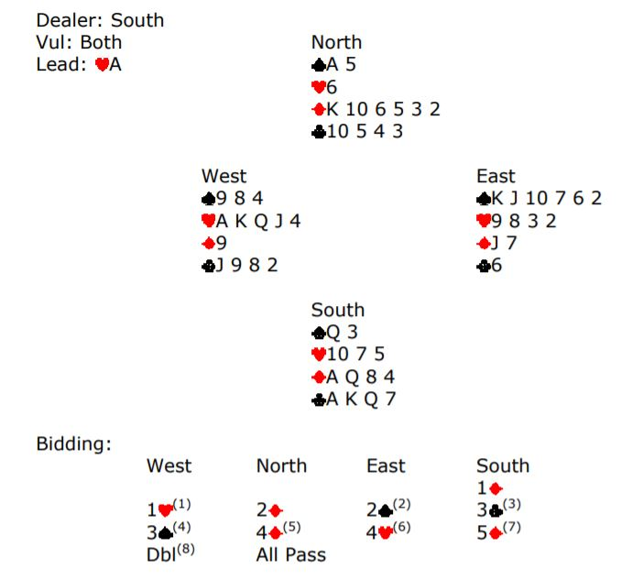
End Plays
Contract 5♦ doubled by S and W leads ♥A and then ♥K which you ruff on dummy. Then the ♦6 to the Q and lead your last ♥ and ruff in dummy. Draw the last trump and start on with ♣AK finding out the bad split. Now you are faced with losing a♣ , and a ♠ , as well as the previous ♥loser. All is not lost, now give up a♠ by playing ♠A first then the ♠5 and W has no clubs to lead so has to concede a ruff and discard, enabling you to dump ♣ 7 whilst ruffing on dummy

